Slide 1
Neural fitted Q

Slide 2
Objectives
Reinforcement Learning: sequential feedback, evaluative feedback, sampled feedback, tabular representation
Generalization needs
The Cart-pole environment
Select the neural architecture
Select what to optimize
Select the exploration strategy
Select an optimization method
Neural Fitted Q (NFQ)
Challenges

Slide 3
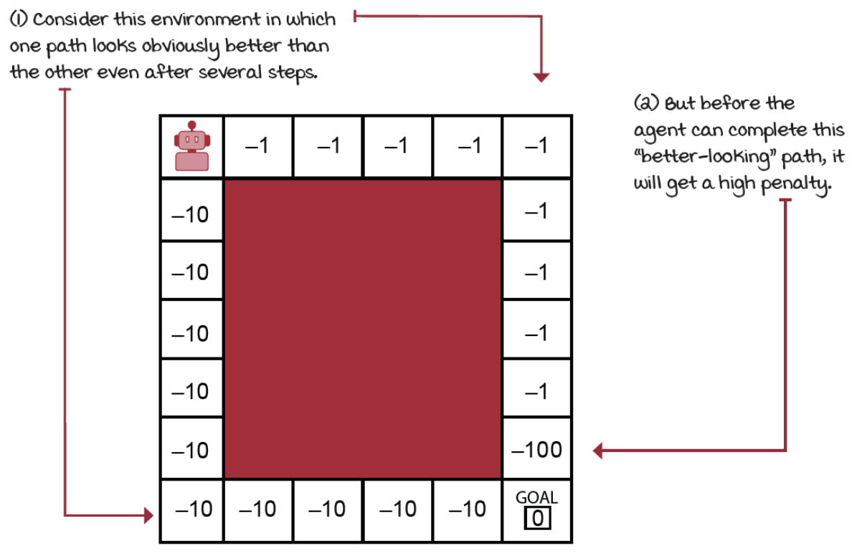

Challenges: sequential feedback
The Agent receives delayed feedback
chess: you make wrong moves early on, but consequences only manifest at the end
It is tricky to interpret the source of the feedback and rise the temporal credit assignment problem
determining which state-action pair is responsible for a reward
In supervised learning decisions don’t have long-term consequences
classifying an image (correctly or not) has no bearing on future performance

Slide 4
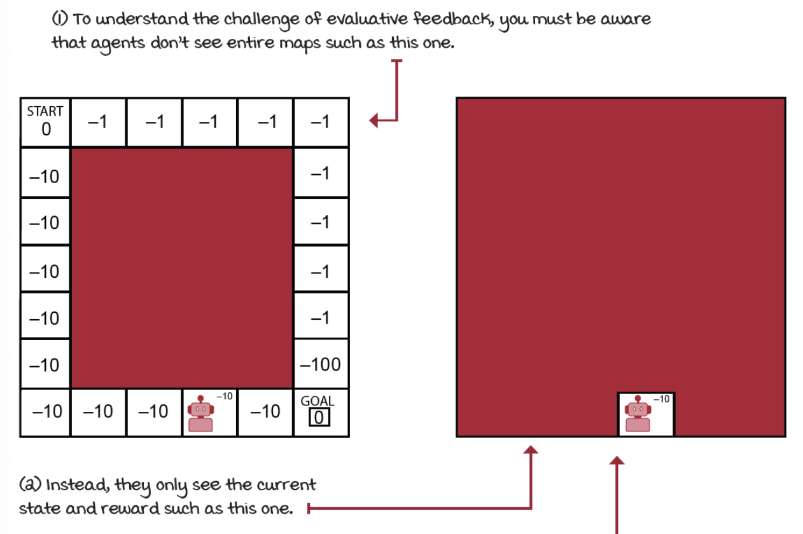

Challenges: evaluative feedback
The goodness of the feedback is only relative
the environment is uncertain
agent doesn’t know the actual dynamics of the environment
The agent must explore, but it misses capitalizing on its current knowledge
exploration-exploitation trade-off
The opposite is supervised feedback
In ML during learning, the model is given correct labels for each samples

Slide 5
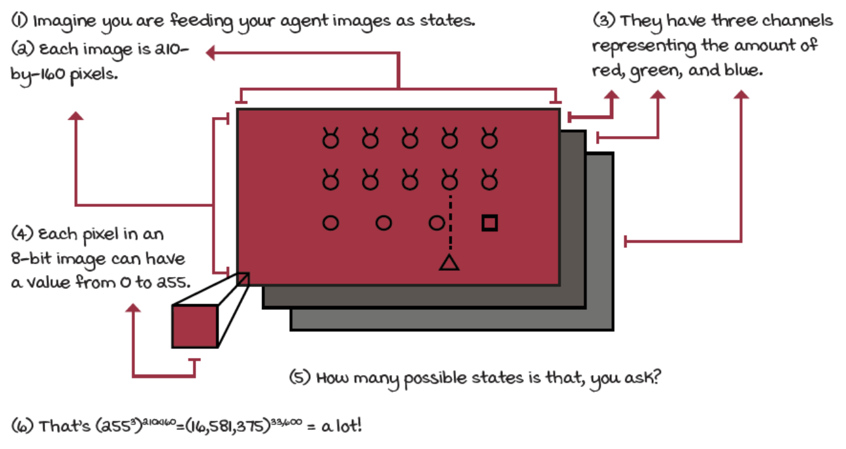
Challenges: sampled feedback
In real problems, agents are unlikely to sample all possible feedback exhaustively
common assumptions "sampling every state-action pair infinitely often” are reasonable in small grid worlds with finite state and action spaces
The core of supervised learning is to learn from sampled feedback in order to be able to generalize to new samples

Slide 6
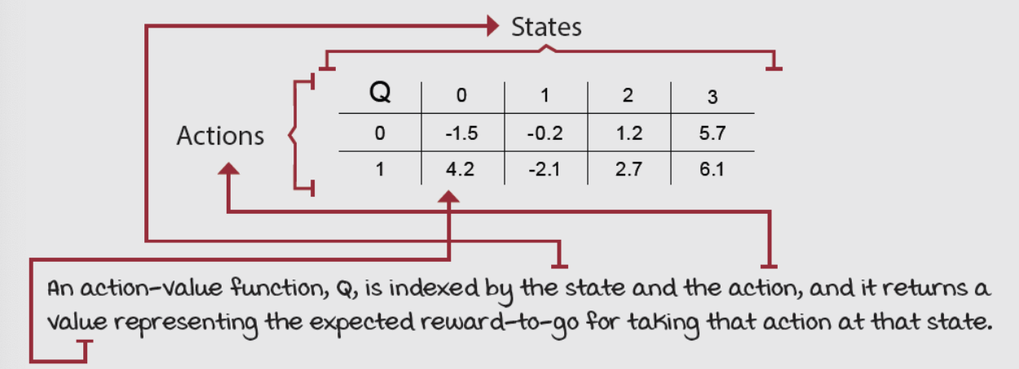
Challenges: tabular representation
The use of a table to represent value functions is no practical in complex problems
for example, Q-learning estimates the optimal action-value function by a matrix indexed by states and actions
Environments can have high-dimensional state spaces (the number of variables that comprise a single state is vast) or can additionally have continuous variables (a single variable can take on an infinite number of values)

Slide 7
Generalization needs
In real tasks the state space is combinatorial and enormous
we cannot expect to find an optimal policy
the goal instead is to find a good approximate solution
One problem is the memory needed for large tables and the time needed to fill them accurately
Even worst, in real tasks, almost every state encountered will never have been seen before
it is necessary to generalize from previous experience with different (but in some sense similar) states
How can experience with a limited subset of the state space be generalized to produce a good approximation over a much larger subset?
generalization from examples has been extensively studied in Machine Learning
we need to combine RL methods with existing generalization methods
The kind of generalization is called function approximation
takes examples from a desired function (e.g. value function)
attempts to generalize from them to construct an approximation of the entire function

Slide 8
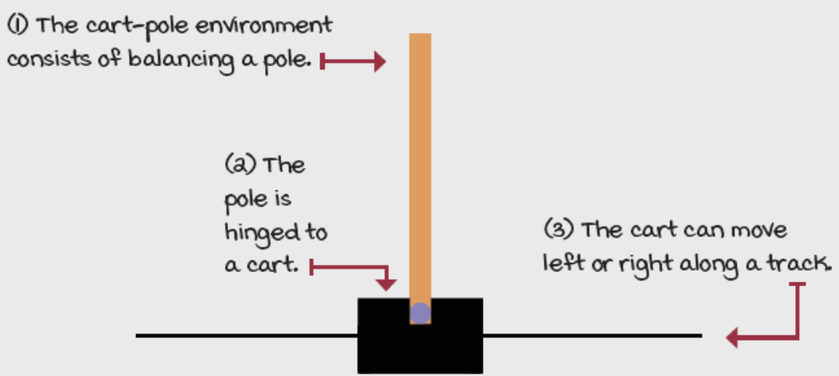
The Cart-pole environment
It is a classic in reinforcement learning
state space has four variables
position on the track (x-axis)
velocity along the track (x-axis)
angle
velocity at the tip
two available actions in every state
action 0 applies a –1 force to the cart (push it left)
action 1 applies a +1 force to the cart (push it right)
The cart reach a terminal state if the angle is more than 12 degrees away from the vertical position; the centre is more than 2.4 units from the centre of the track; and the episode count reaches 500 time steps.
The reward function is +1 for every time step
State space is low dimensional but continuous
Training is fast and function approximation can help

Slide 9
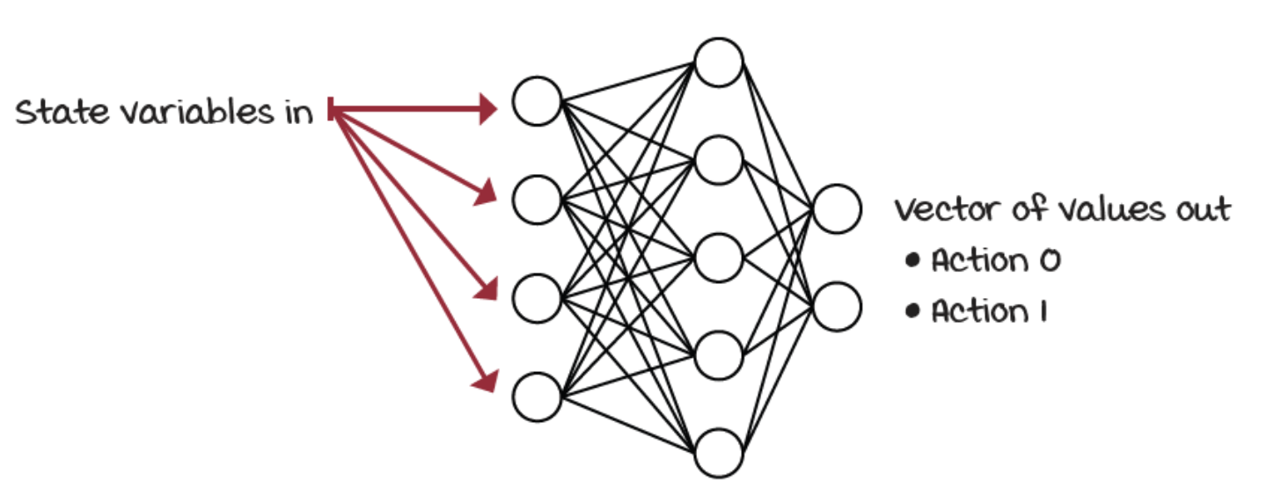
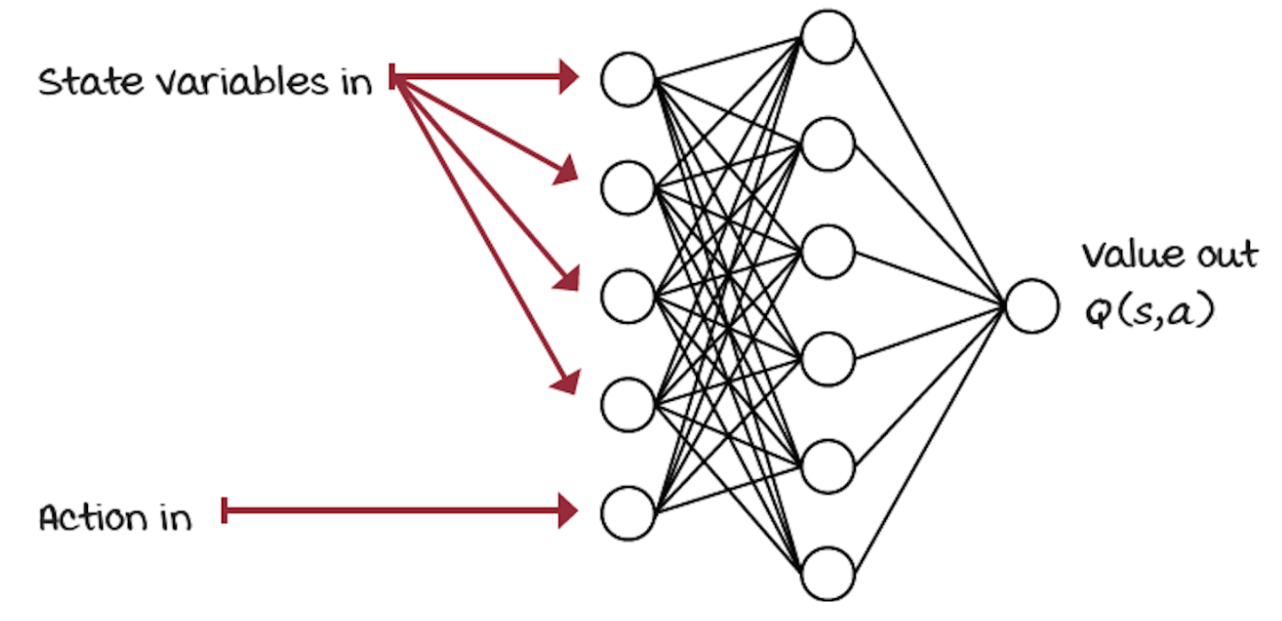
Select the neural architecture (2)
We refer to the approximate action-value function as Q(s,a; theta)
Q estimate is parameterized by theta
the weights of a neural network

Slide 10
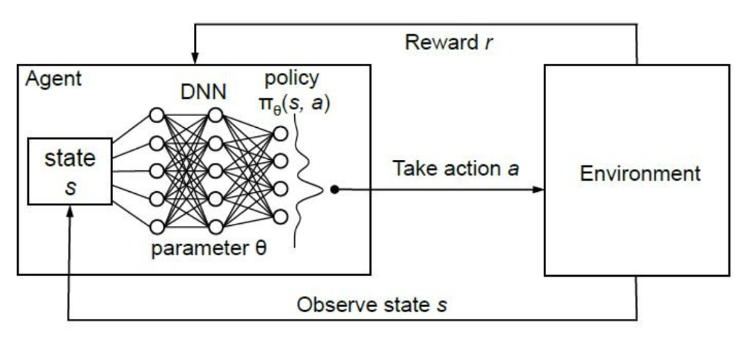
Select the neural architecture (2)

Slide 11


Select what to optimize (1)
Loss function: a measure of how well our predictions are
MSE (mean squared error, or L2 loss)
average squared difference between the "predicted" and "true" values
straightforward in supervised learning (training/test set): in RL the "predicted values" are those from the neural network, but the "true values"?
We don’t have sample of that optimal values, but remember that
we can use the same principle of generalized policy iteration: alternate between policy-evaluation and policy-improvement
however, using non-linear approximation cannot guarantees convergence
We can use as "true values" the TD targets, which depend on a prediction also coming from the network, the value of the next state, in a circular dependency

Slide 12
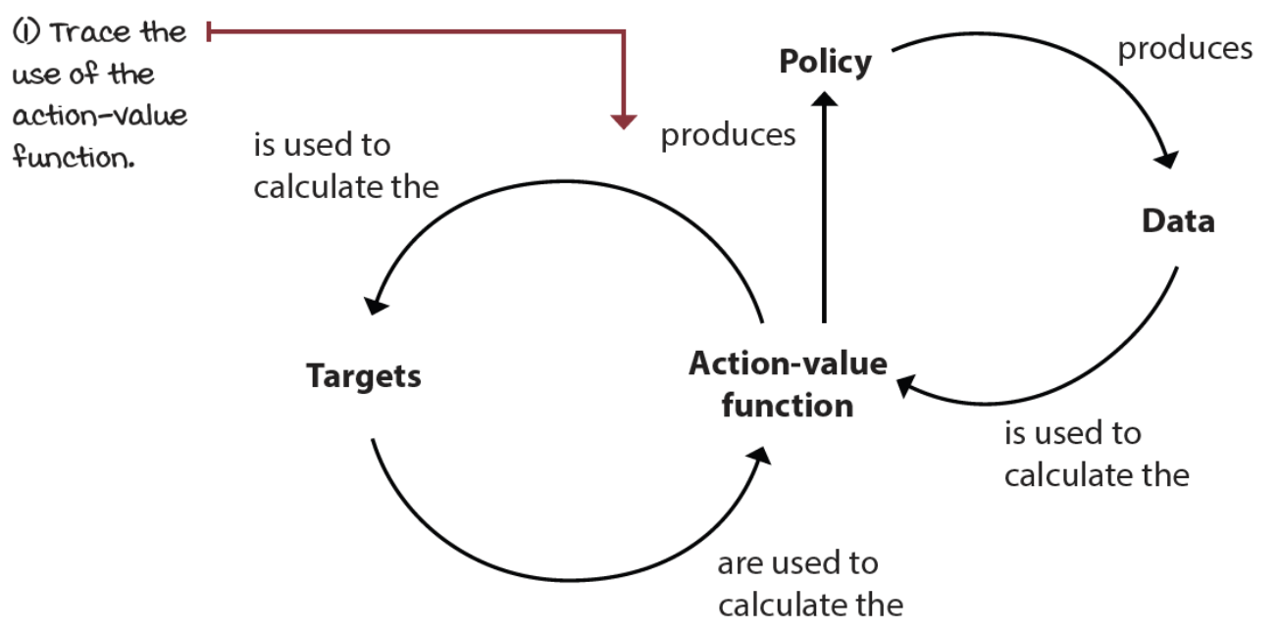
Select what to optimize (2)
This circular dependency is bad: it’s not well behaved because it doesn’t respect several of the assumptions made in supervised learning problems

Slide 13
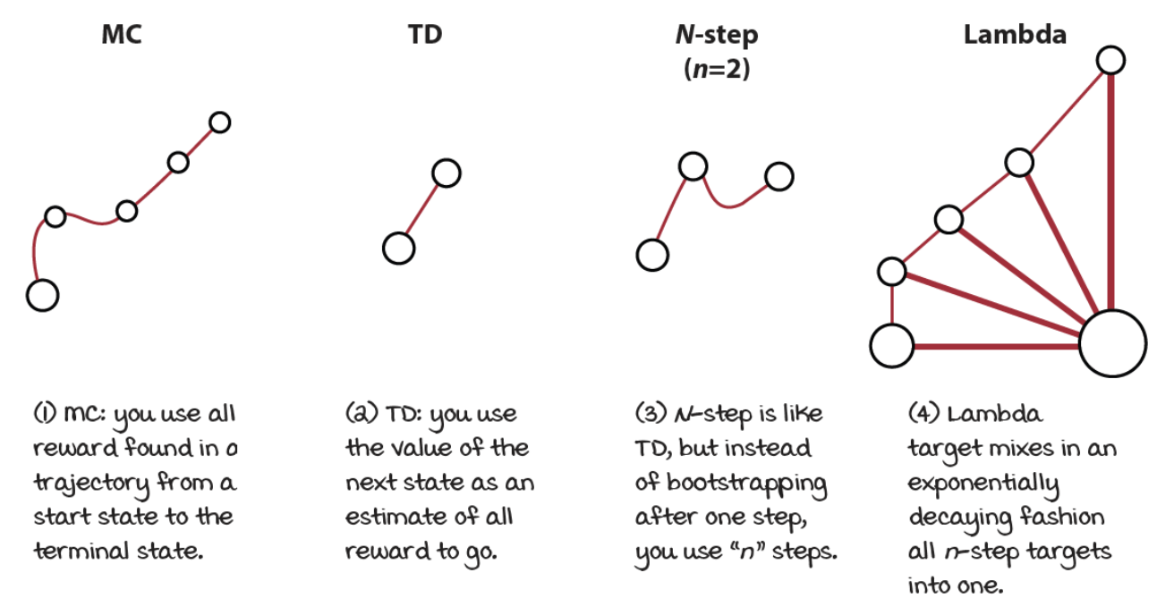
Select what to optimize (3)
There are multiple ways we can evaluate a policy:

Slide 14
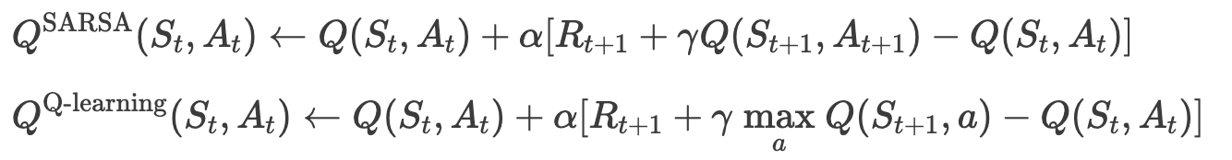
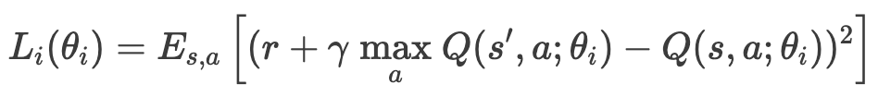
Select what to optimize (4)
We can use any of these targets and get solid results, however we keep things simple and use the off-policy TD target (Q-learning):
Now, we can substitute in the loss function definition:
In ML we have predicted values (from the learning model) and true values (commonly constants and provided in advance)
In RL, the "true values" depend on predicted values themselves: they come from the model, however they should be treated as a constant.

Slide 15
Select the exploration strategy
We need to balance the exploration-exploitation trade-off
almost any technique would work fine
to keep things simple, we’re going to use an epsilon-greedy strategy
Remember that the implication of the off-policy learning: two policies
a policy that generates behaviour (in this case is an epsilon-greedy policy)
a policy that we’re learning about
However, when evaluating the agent, we will use the action greedy with respect to the learned action-value function

Slide 16
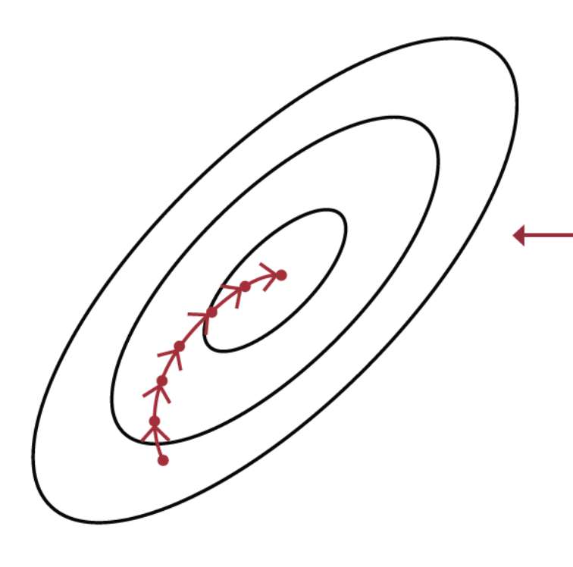
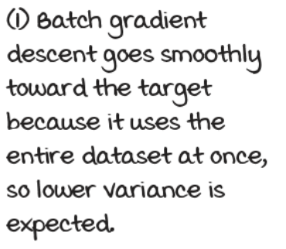
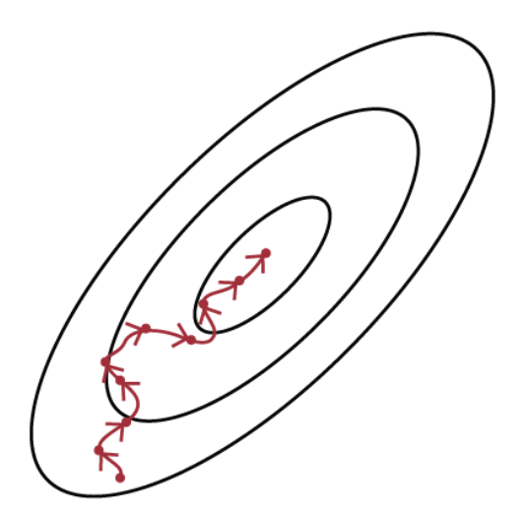
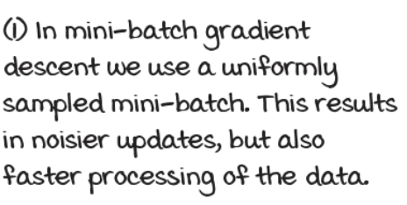
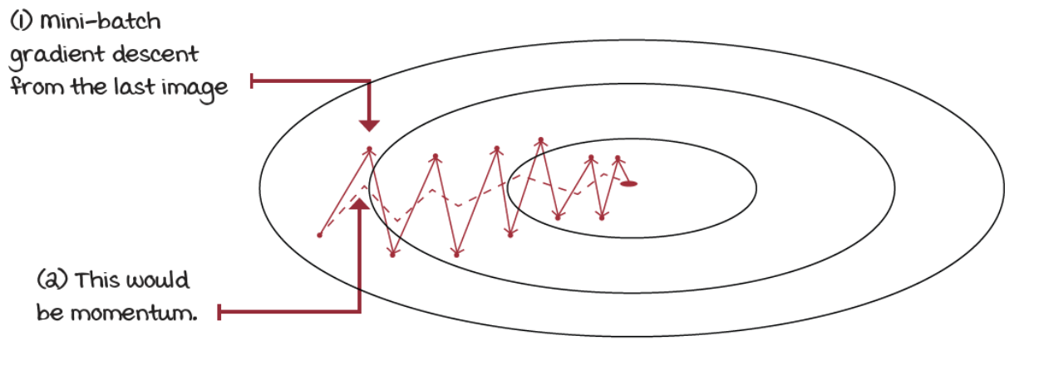
Select an optimization method
Gradient Descent method needs a couple of assumptions:
data must be independent and identically distributed (IID)
targets must be stationary
in RL we cannot ensure any of these assumptions
We need a robust optimization method
Batch Gradient Descent:
takes the entire dataset, calculates the gradient and steps toward this gradient a little bit at a time
we don’t even have a dataset in advance, so it isn’t applicable
Mini-batch gradient descent
only a fraction of the data at a time (mini-batch)
Gradient descent with momentum
updates weights in the direction of the moving average of the gradients, instead of the gradient itself
Others: root mean square propagation (RMSprop), adaptive moment estimation (Adam)

Slide 17
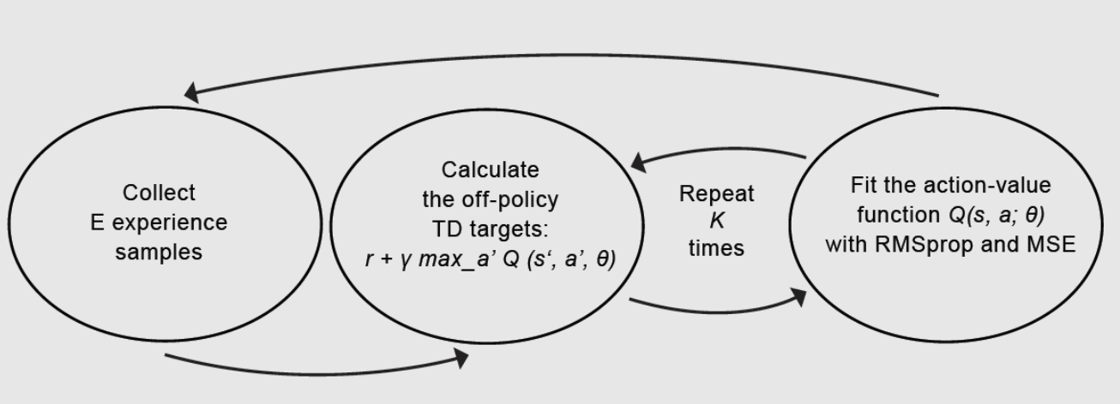
Neural Fitted Q (NFQ) (1)
Now we can put things together:
approximate 𝑄(𝑠,𝑎;𝜃) using a fully connected NN
use the off-policy TD targets (𝑟 + 𝛾 max_{𝑎}𝑄(𝑠′,𝑎;𝜃)) to evaluate policies
use an epsilon-greedy strategy to improve policies
use mean squared error (MSE) for the loss function
and use RMSprop as optimizer
The full neural fitted Q-iteration (NFQ) algorithm has three main steps:

Slide 18
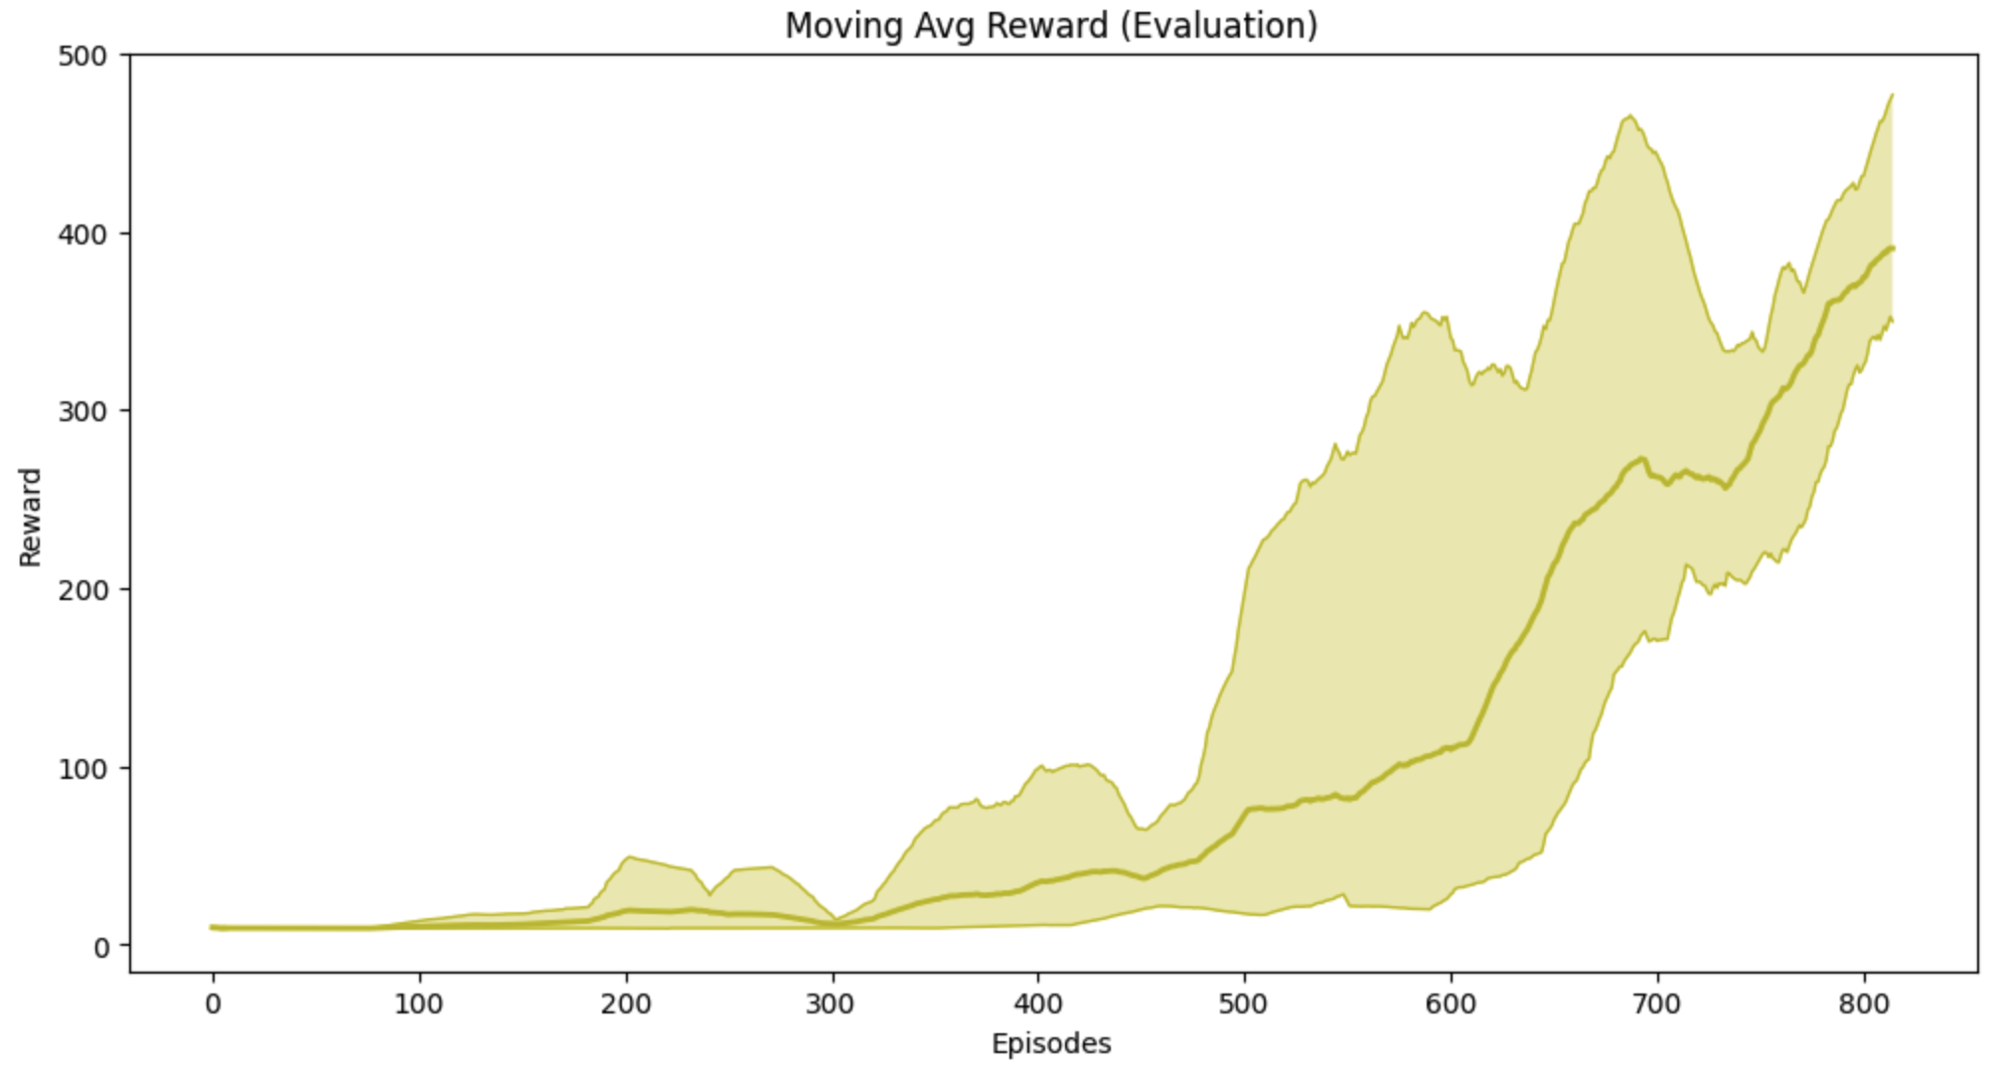
Neural Fitted Q (NFQ) (2)
NFQ is not a state-of-the-art solution, however in a simple environment as the cart-pole, it shows a decent performance
See neural-fitted-q.ipynb notebook

Slide 19
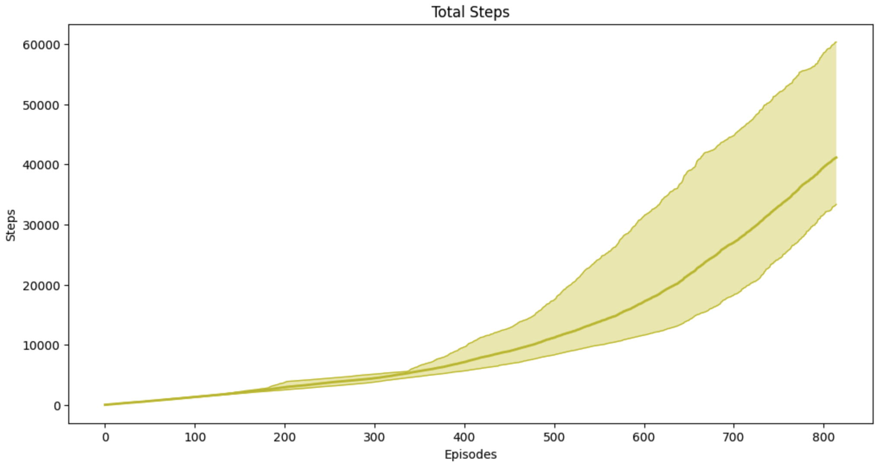
Neural Fitted Q (NFQ) (3)
The main issue with NFQ is that it takes too many steps to get decent performance
NFQ does poorly in terms of sample efficiency

Slide 20
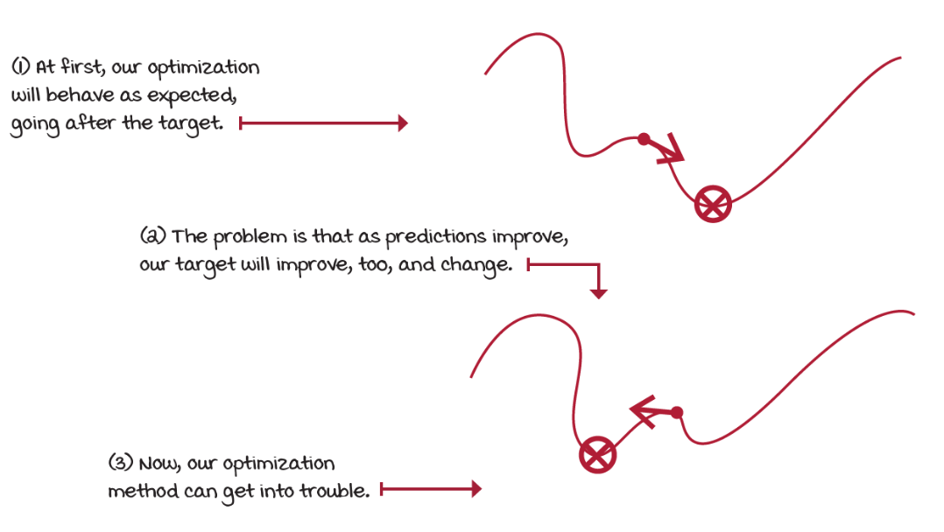
Challenges (1)
Notice that we’re using a non-stationary target for the learning updates
as we update the weights of the approximate Q-function, the targets also move and make our most recent update outdated
Training becomes unstable quickly

Slide 21
Challenges (2)
We batched K experience samples, collected online, and update the NN from that mini-batch
these samples are correlated, they come from the same trajectory and policy
later we use different mini-batches that are also internally correlated, but likely different from previous mini-batches
This means that we aren’t holding the IID assumption,
optimization methods assume data samples independent and identically distributed
We’re training on almost the exact opposite
samples are not independent
the outcome of a new state is dependent on current state
samples aren’t identically distributed
underlying data generating process, the policy, is changing over time
optimization methods allow to relax the IID assumption to a certain degree, but we go all the way

